Slide 1

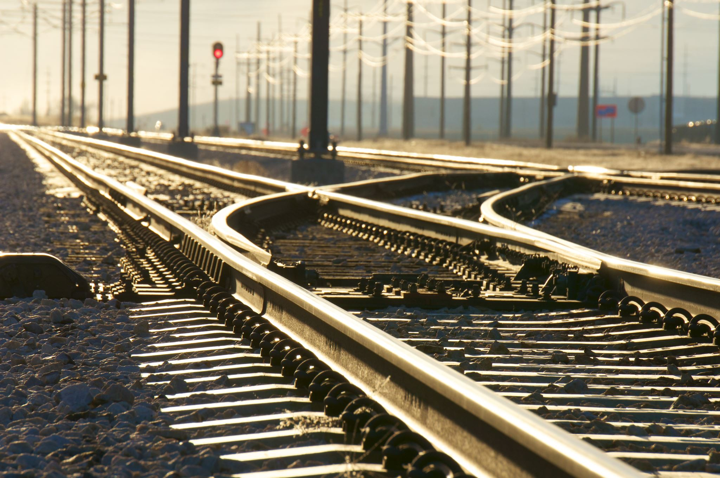
Z-STATION
…not z-destination

Slide 2
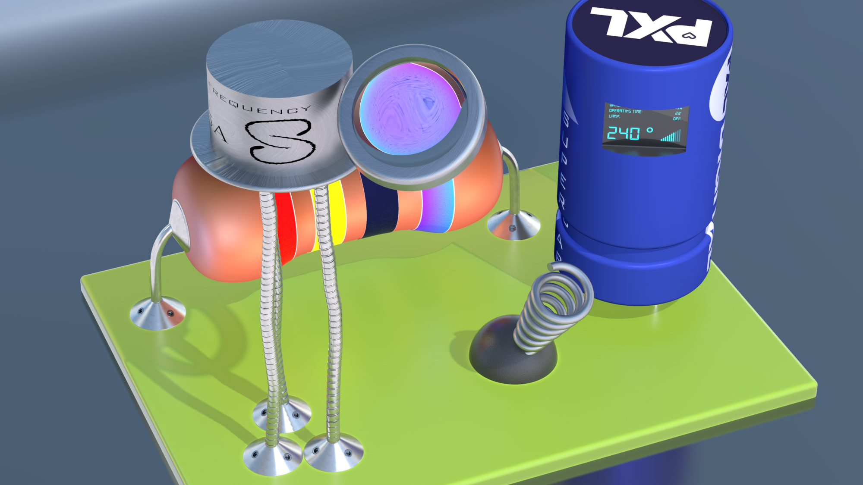
The idea

Slide 3

Z-process

Slide 4
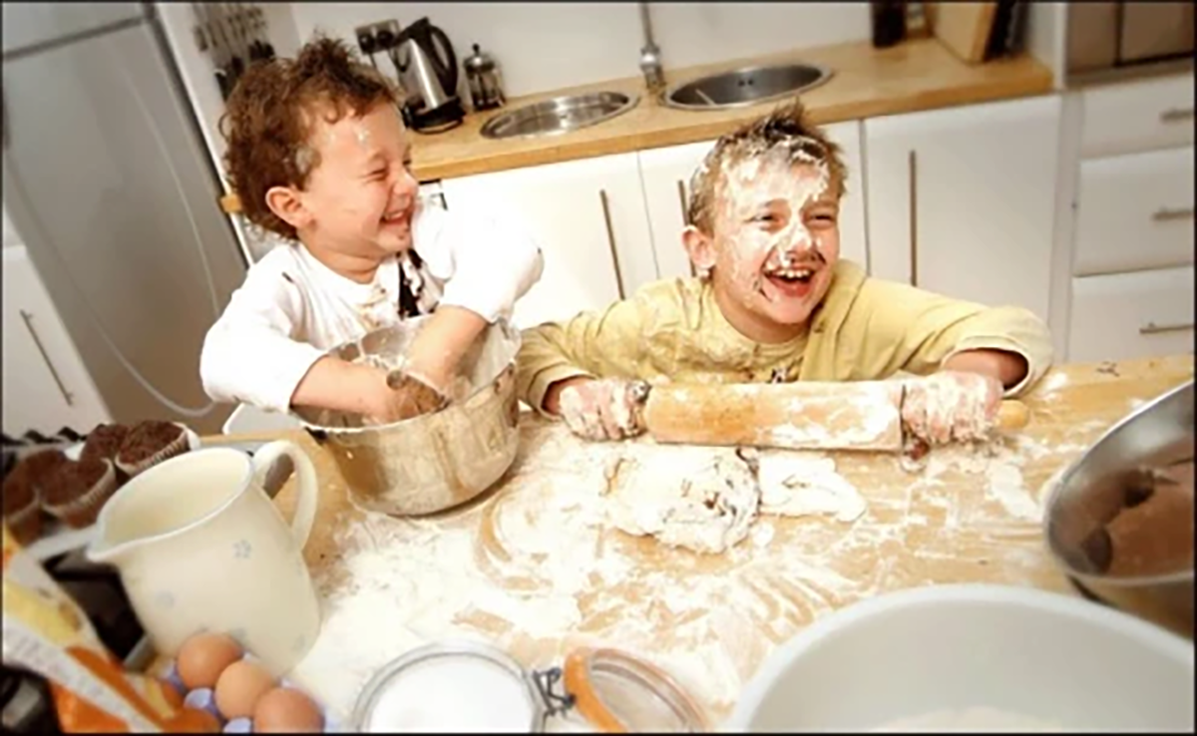
The fun part…

Slide 5
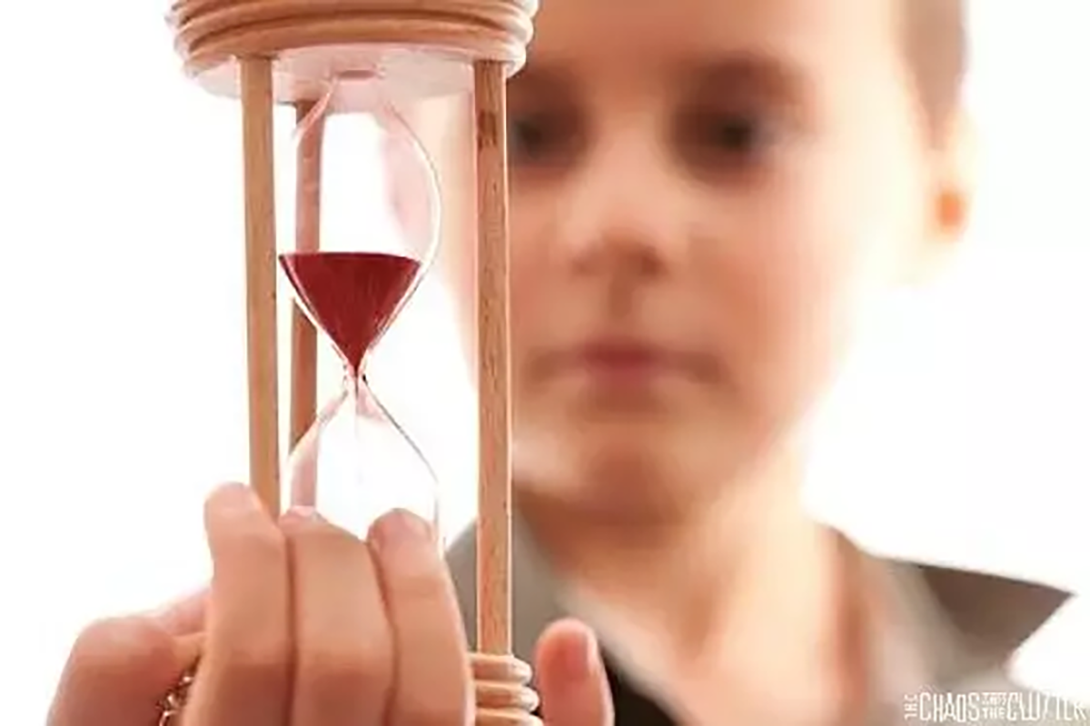
…, the waiting…

Slide 6
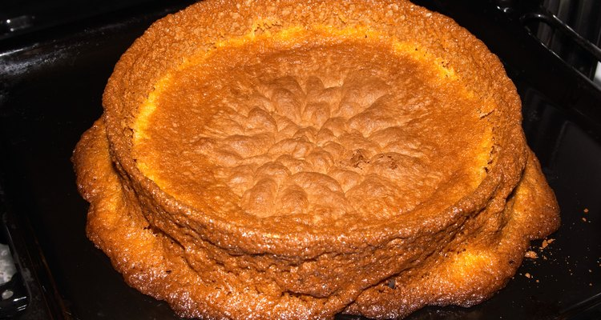
…the learning starts.

Slide 7

The joy, the pleasure during the production process!

Slide 8
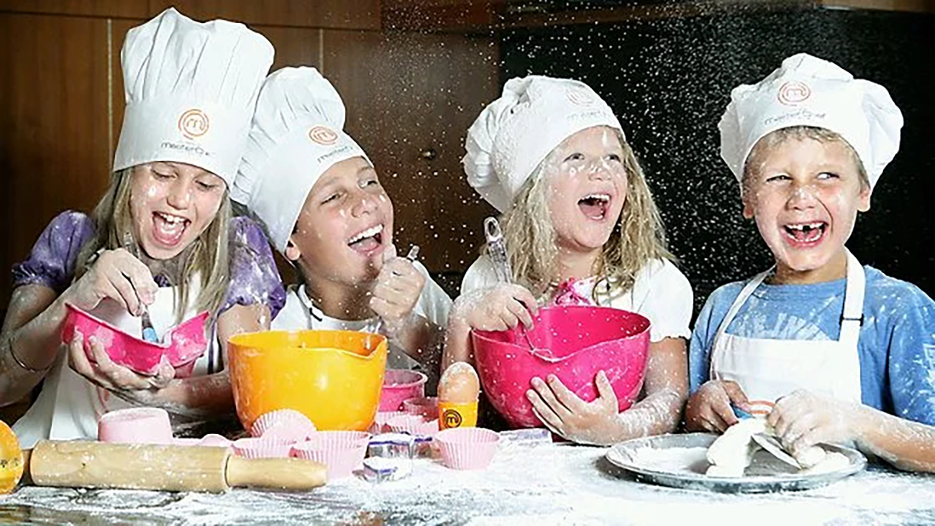
The joy, the pleasure during the production process!

Slide 9
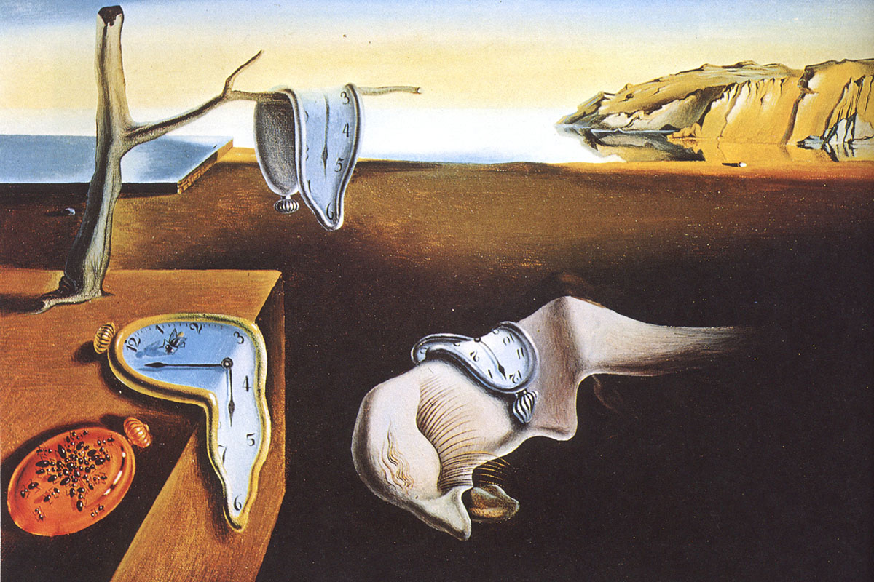
Time is relative…

Slide 10


Slide 11

CATCH

Slide 12


Slide 13
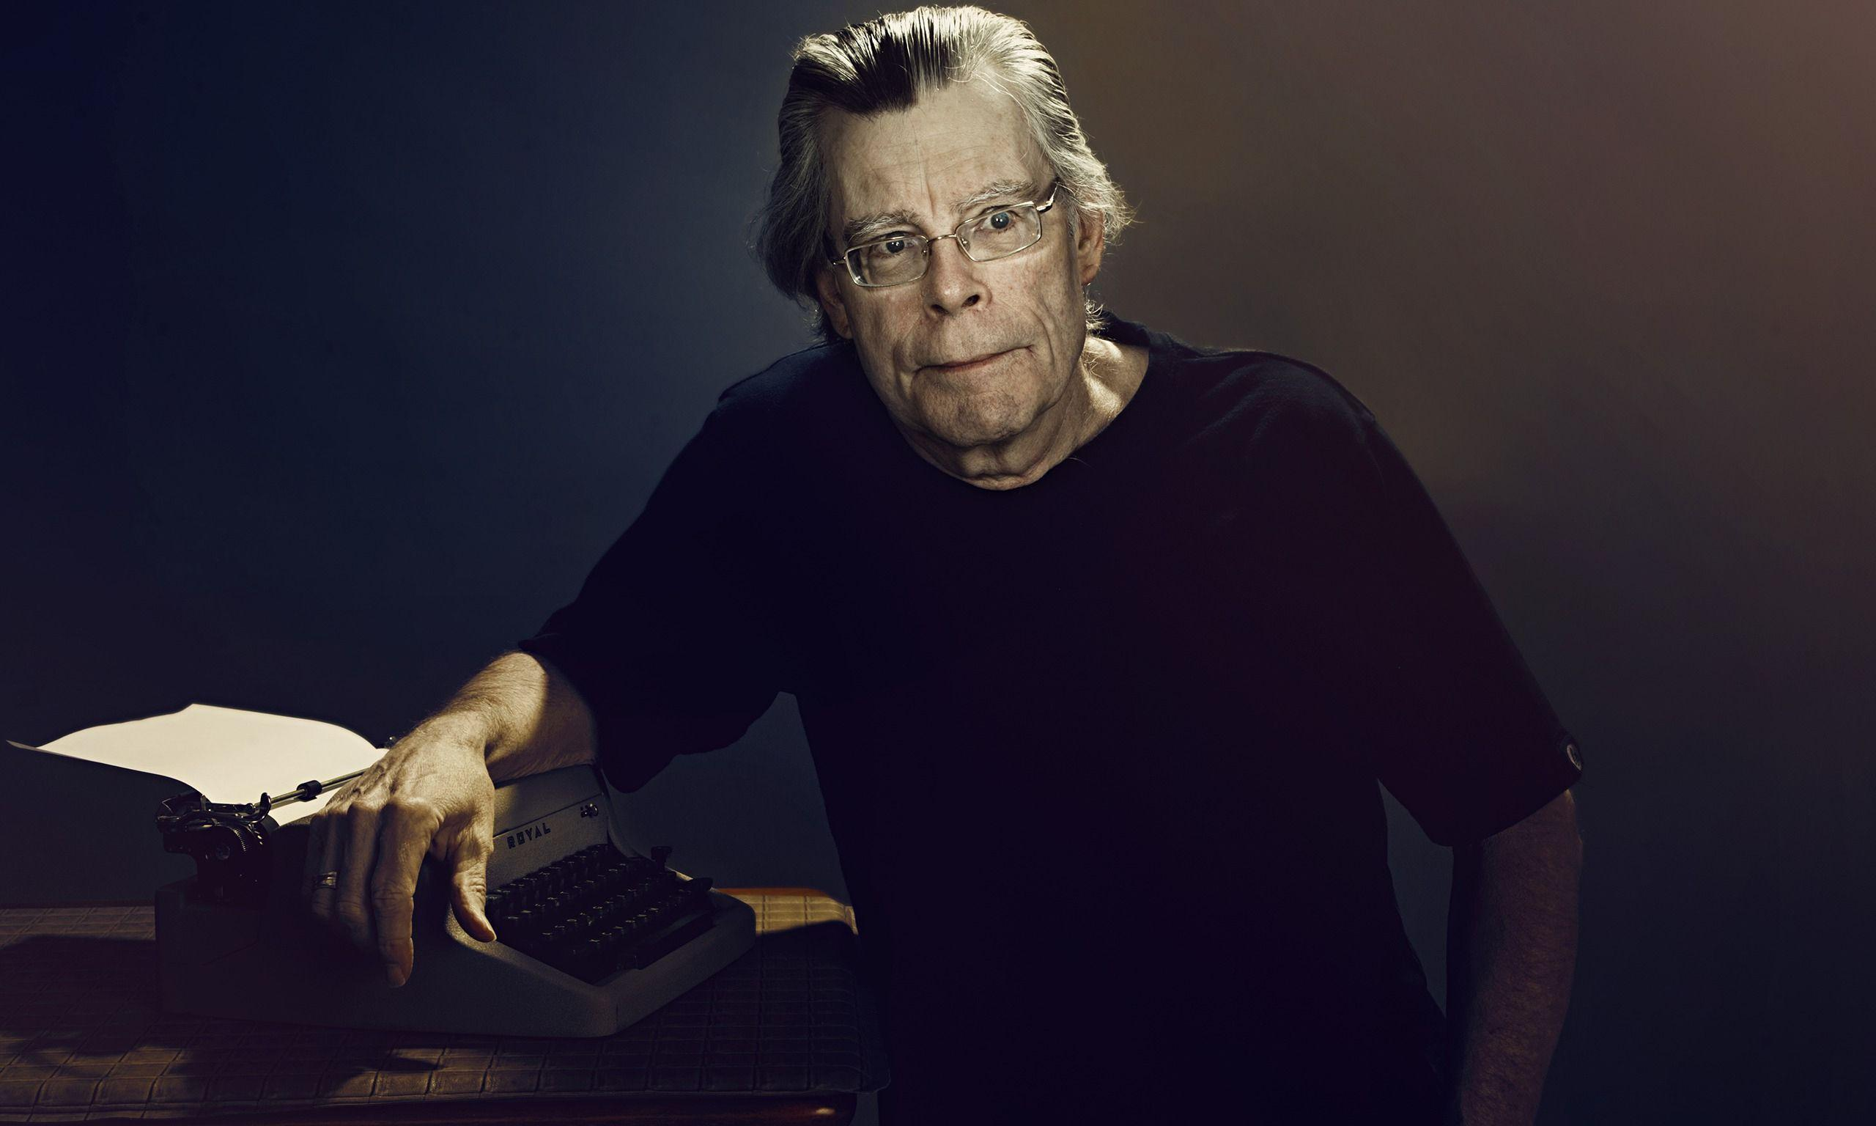

Slide 14

PARADOX

Slide 15
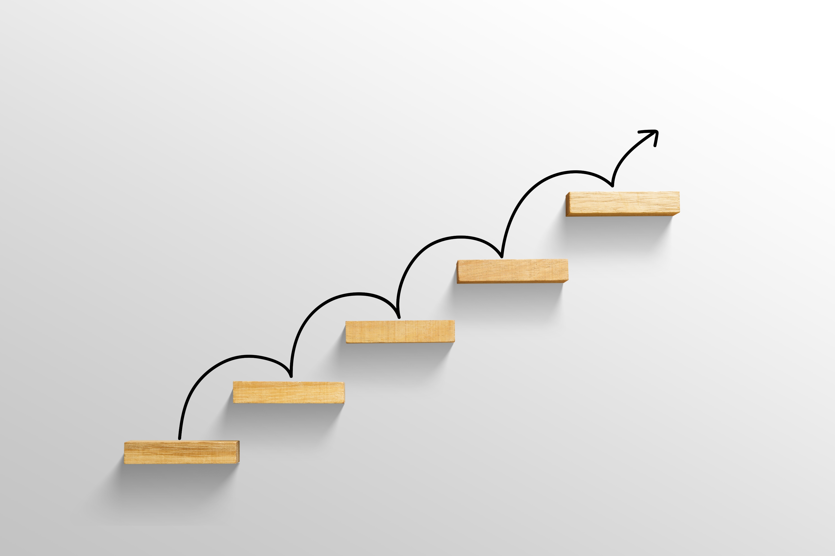

Slide 16
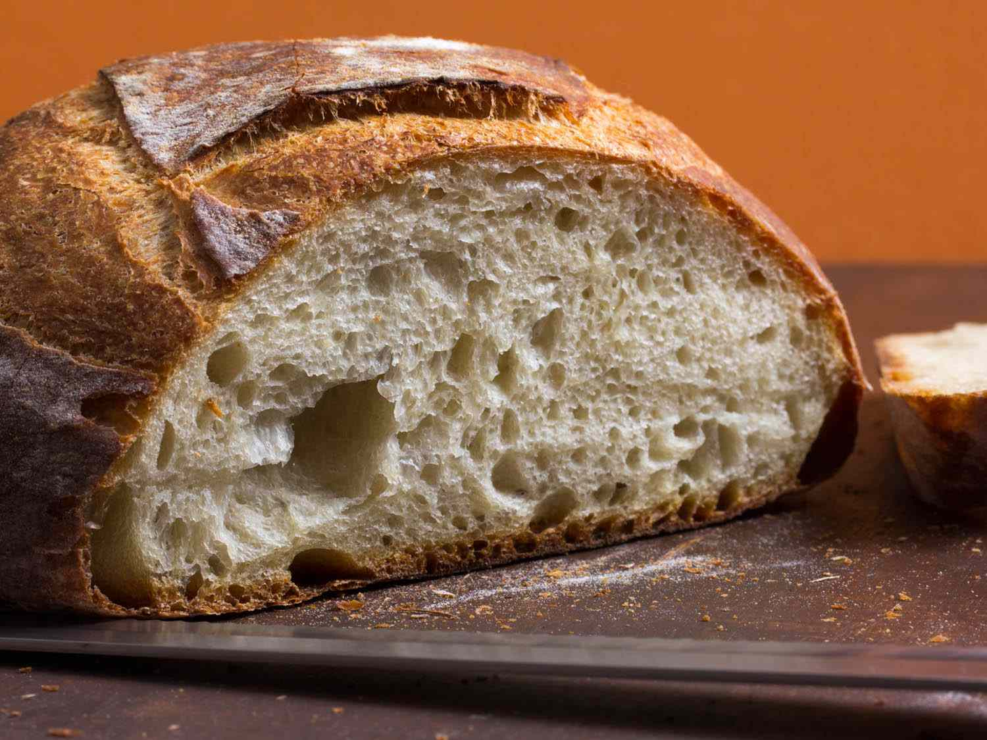
bread

Slide 17


Slide 18
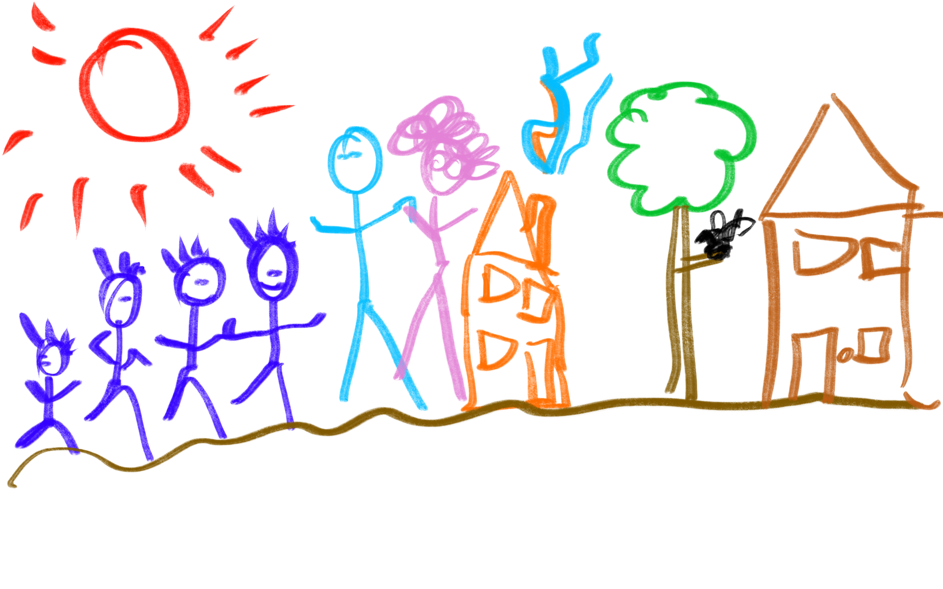
We all had toothaches that day…

Slide 19
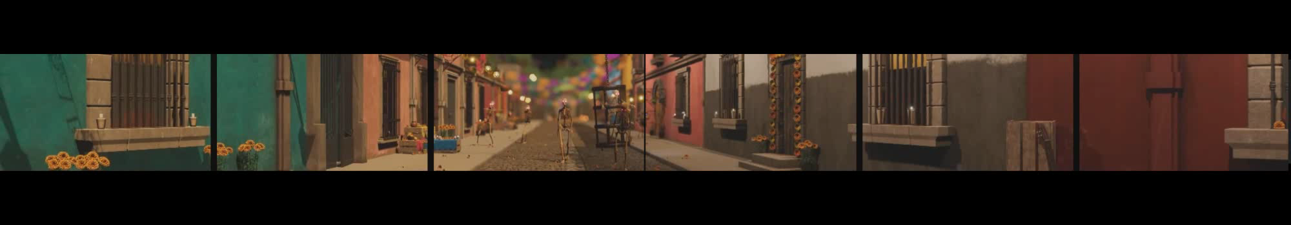
< 80ft wide 6 screens >
50 seconds out of 8 minutes total duration
40 weeks of pleasure in creation
Ready for another spin…?
…lifetime learning ;)
By Stephan Eersels

